Slide 1
MALCOM Machine Learning for Communication Systems Lecture 10 Communication-efficient Edge AI/ML & Federated Learning Spring 2024
Jaiprakash Nagar
(Slides: Marios Kountouris)

Slide 2
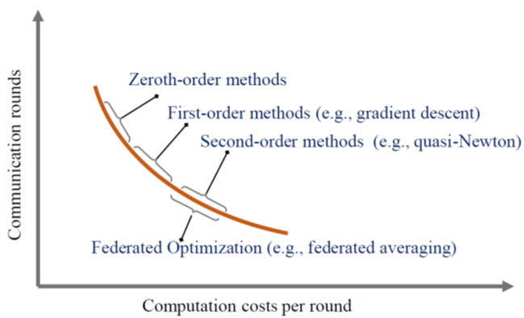
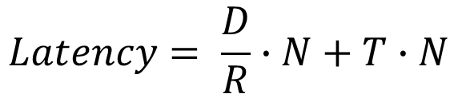
Communication-Efficient Edge AI Taxonomy
Communication-efficient Edge AI
Algorithmic level
System level
Zeroth order
First order
Second order
Federated Optimization
Data partition based edge training
Model partition based edge training
Computation Offloading based edge inference
Coded edge computing
Communication vs. Computation
$$Latency= \frac{D}{R}∙N+T∙N$$
communication
computation
D: total size of info per round, R: communication rate, N: # comm. rounds, T: total computation time
Notes:
Ajouter une photo d’un vieux telegraphe, puis un mobile satellitte ancienne generation…can someone find an even older wireless communication system (smoke)

Slide 3
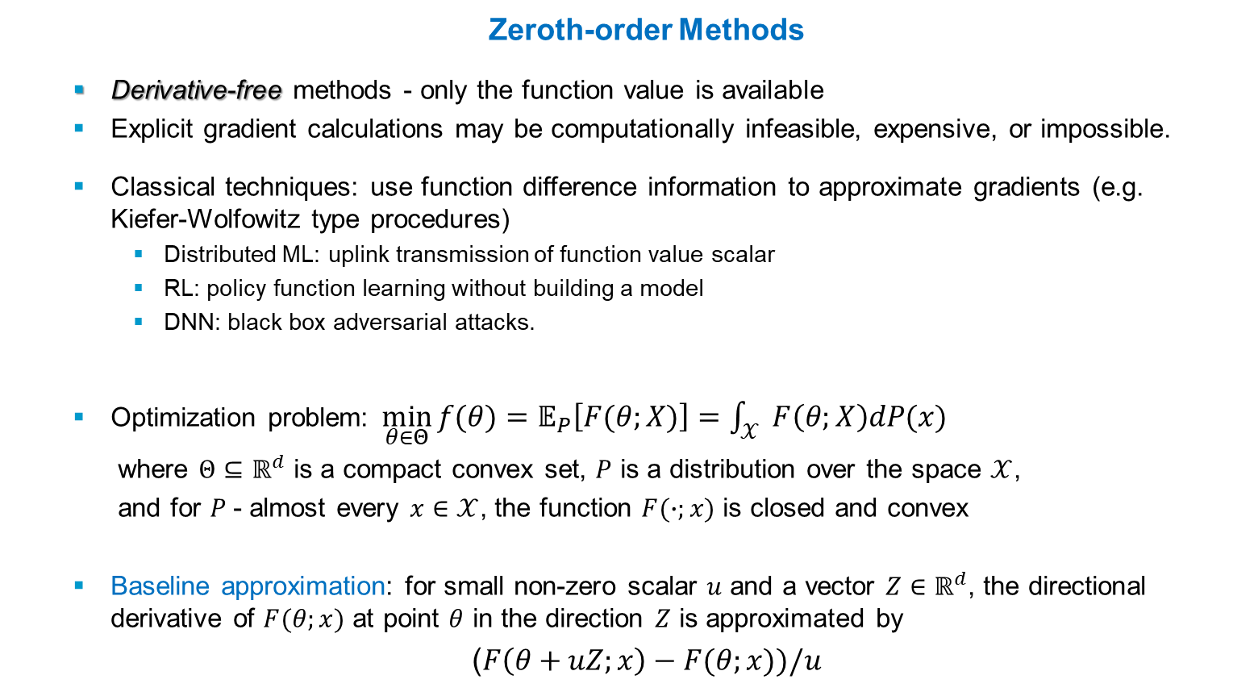
Communication-efficient Algorithms
Zeroth-order Methods
Derivative-free methods - only the function value is available
Explicit gradient calculations may be computationally infeasible, expensive, or impossible.
Classical techniques: use function difference information to approximate gradients (e.g. Kiefer-Wolfowitz type procedures)
Distributed ML: uplink transmission of function value scalar
RL: policy function learning without building a model
DNN: black box adversarial attacks.
Optimization problem:$\min_{θ∈Θ}{f(θ)}=𝔼_{P}\left[F(θ;X)\right]=\int_{𝒳}{F\left(θ;X\right)dP(x)}$
where $Θ⊆ℝ^{d}$ is a compact convex set, $P$ is a distribution over the space $𝒳$,
and for $P$- almost every $x∈𝒳$, the function $F(∙;x)$ is closed and convex
Baseline approximation: for small non-zero scalar $u$ and a vector $Z∈ℝ^{d}$, the directional derivative of $F(θ;x)$ at point $θ$ in the direction $Z$ is approximated by
($F\left(θ+uZ;x\right)−F(θ;x))/u$
Notes:
Ajouter une photo d’un vieux telegraphe, puis un mobile satellitte ancienne generation…can someone find an even older wireless communication system (smoke)

Slide 4
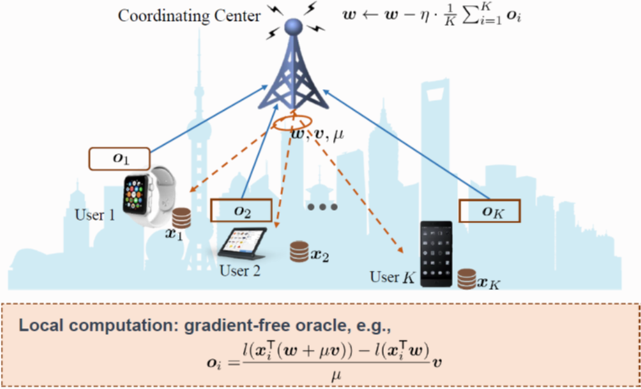
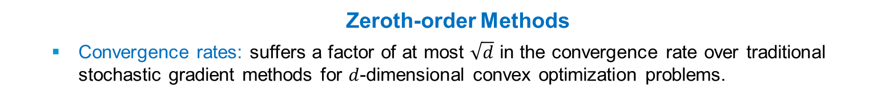
Communication-efficient Algorithms
Zeroth-order Methods
Convergence rates: suffers a factor of at most $\sqrt{d}$ in the convergence rate over traditional stochastic gradient methods for $d$-dimensional convex optimization problems.
Distributed zeroth-order methods
Objective: reduce number of per-device communications
Some approaches:
At each iteration each device communicates with its neighbors with some probability (independent from others and the past), which decays to zero at a carefully tuned rate.
Exchange only quantized data information (even 1 bit)
Notes:
Ajouter une photo d’un vieux telegraphe, puis un mobile satellitte ancienne generation…can someone find an even older wireless communication system (smoke)

Slide 5
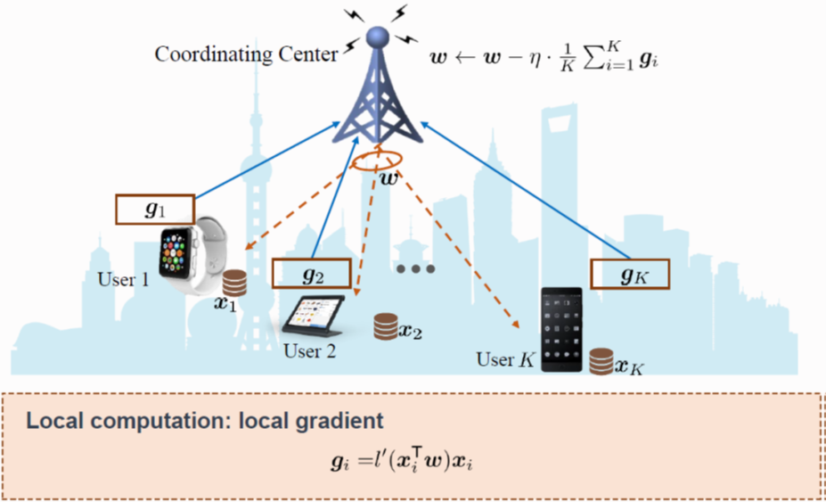
Communication-efficient Algorithms
First-order Methods
Most commonly used algorithms - mainly based on gradient descent methods
Computational complexity per iteration scales with # data samples and model dimensions
SGD: only one training sample is used to compute the gradient at each iteration.
Two main approaches:
Communication round minimization
by accelerating the convergence
rate of the learning algorithms
Communication overhead per round reduction
(e.g., gradient reuse,
quantization, sparsification,
sketching based compression)
Notes:
Ajouter une photo d’un vieux telegraphe, puis un mobile satellitte ancienne generation…can someone find an even older wireless communication system (smoke)

Slide 6
First-order Methods: Taxonomy of Distributed SGD
Four Dimensions
Communication Synchronization
Comp.- Comm. Parallelism
Synchronous
Stale Synchronous
Asynchronous
Local SGD
Pipelining
Scheduling
Distributed SGD
System Architectures
Reduction techniques
Parameter Server
All Reduce
Decentralized/Gossip
Quantization
Sparsification
Coding
Compression
Notes:
Ajouter une photo d’un vieux telegraphe, puis un mobile satellitte ancienne generation…can someone find an even older wireless communication system (smoke)

Slide 7
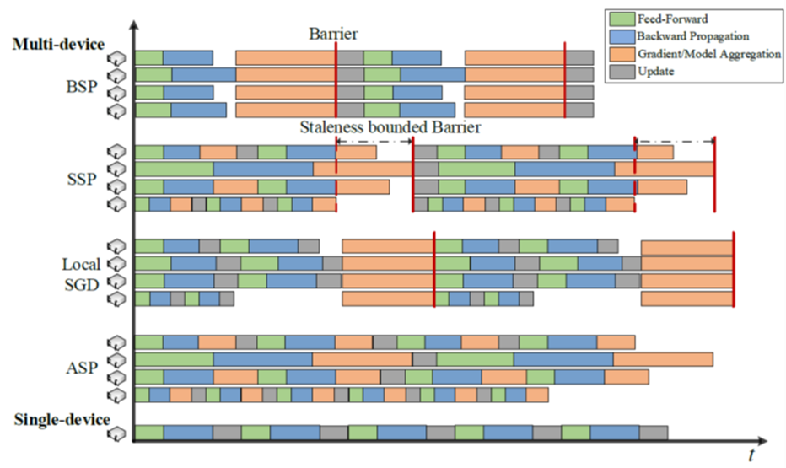
DistSGD: Communication Synchronization
“Best” split depends on # workers and how frequently each worker needs to work with others
Synchronous: every worker wait for all workers to finish transmitting all parameters in the current iteration, before the next training.
Stale Synchronous: faster workers do more updates than slower ones. staleness bounded barrier to guarantee convergence: limits the iteration gap between fastest and slowest worker.
Asynchronous: each worker transmits its gradient as soon as it’s calculated. The PS updates the global model without waiting for the other workers.
Synch
Local SGD: each worker runs several or more iterations itself, and then PS averages all local models into the newest
Notes:
Ajouter une photo d’un vieux telegraphe, puis un mobile satellitte ancienne generation…can someone find an even older wireless communication system (smoke)

Slide 8
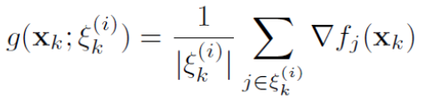
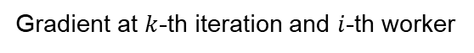
Fully Synchronous SGD
Local stochastic gradients computation
Average local models across all nodes
Gradient at $k$-th iteration and $i$-th worker
Communication time
(PS, all-reduce, …)
gradient computation time
Notes:
Ajouter une photo d’un vieux telegraphe, puis un mobile satellitte ancienne generation…can someone find an even older wireless communication system (smoke)

Slide 9
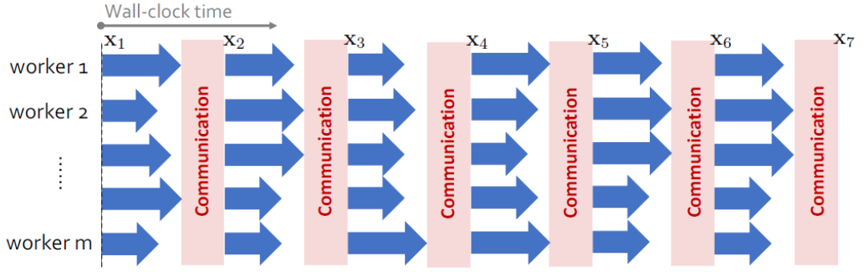
Fully Synchronous SGD
Local stochastic gradients computation
Average local models across all nodes
Repeat the above steps until convergence
Notes:
Ajouter une photo d’un vieux telegraphe, puis un mobile satellitte ancienne generation…can someone find an even older wireless communication system (smoke)

Slide 10
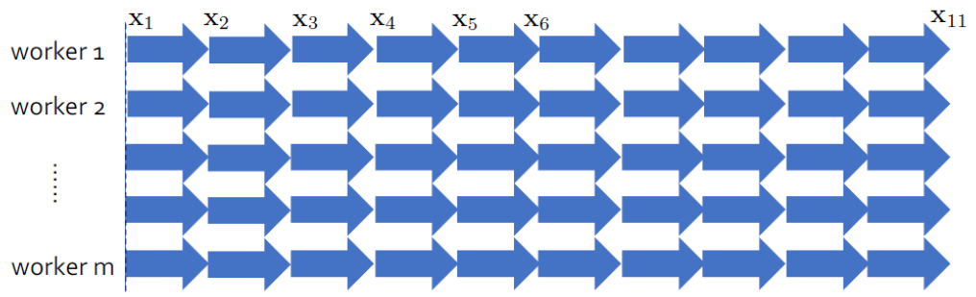
Fully Synchronous SGD
Ideal:
11 iterations
Practice:
7 iterations
Notes:
Ajouter une photo d’un vieux telegraphe, puis un mobile satellitte ancienne generation…can someone find an even older wireless communication system (smoke)

Slide 11
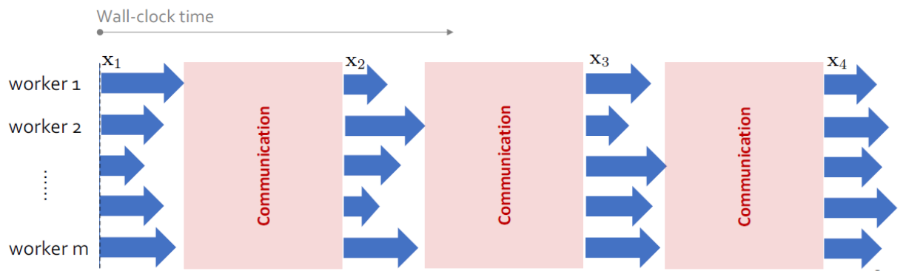
Fully Synchronous SGD in Deep Learning
In DNN training
communication time can be even larger than computation time
Need for communication-efficient distributed SGD
Notes:
Ajouter une photo d’un vieux telegraphe, puis un mobile satellitte ancienne generation…can someone find an even older wireless communication system (smoke)

Slide 12
Asynchronous SGD
Compute
Communicate
Compute
Worker 1
Iteration
Waste
Iteration
Worker 2
Iteration
Iteration
Waste
Worker $m$
Iteration
Waste
Iteration
Async: Remove barriers, communicate and compute whenever each worker likes.
Barrier
Barrier
Notes:
Ajouter une photo d’un vieux telegraphe, puis un mobile satellitte ancienne generation…can someone find an even older wireless communication system (smoke)

Slide 13
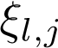
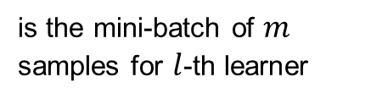
Asynchronous SGD
Parameter Server
w₁
w₁
w₁
Learner 1
Learner 2
Learner P
w₁
w₁
w₁
is the mini-batch of $m$ samples for $l$-th learner
Notes:
Ajouter une photo d’un vieux telegraphe, puis un mobile satellitte ancienne generation…can someone find an even older wireless communication system (smoke)

Slide 14
Asynchronous SGD
Parameter Server
w₂
Learner 1
Learner 2
Learner P
w₂
w₁
w₁
is the mini-batch of $m$ samples for $l$-th learner
Notes:
Ajouter une photo d’un vieux telegraphe, puis un mobile satellitte ancienne generation…can someone find an even older wireless communication system (smoke)

Slide 15
Asynchronous SGD
Parameter Server
Gradient Staleness
w₃
Learner 1
Learner 2
Learner P
w₂
w₃
w₁
No need to wait for stragglers
Gradient Staleness can increase error
Notes:
Ajouter une photo d’un vieux telegraphe, puis un mobile satellitte ancienne generation…can someone find an even older wireless communication system (smoke)

Slide 16
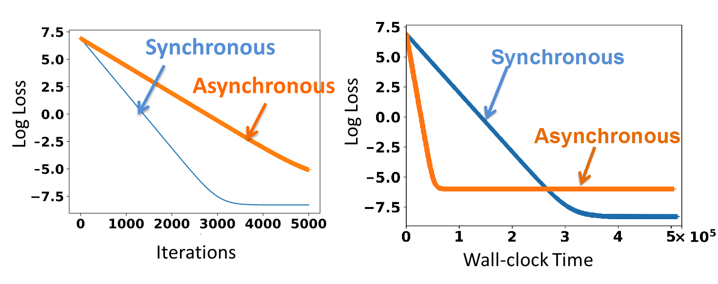
Synchronous vs. Asynchronous SGD
Performance Comparison
Notes:
Ajouter une photo d’un vieux telegraphe, puis un mobile satellitte ancienne generation…can someone find an even older wireless communication system (smoke)

Slide 17
Synchronous vs. Asynchronous
overheads
timeline
GPU 1
GPU 2
GPU 3
guaranteed to be correct
can be slow due to stragglers, overhead
stragglers
Asynchronous World
GPU 1
Faster – no waiting
Easier to implement
GPU 2
GPU 3
there may be errors
Notes:
Ajouter une photo d’un vieux telegraphe, puis un mobile satellitte ancienne generation…can someone find an even older wireless communication system (smoke)

Slide 18
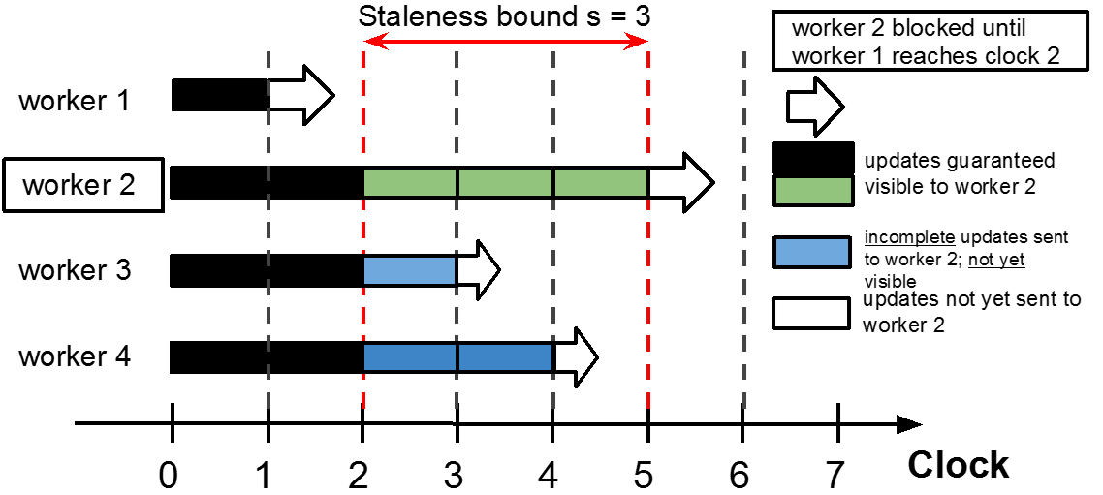
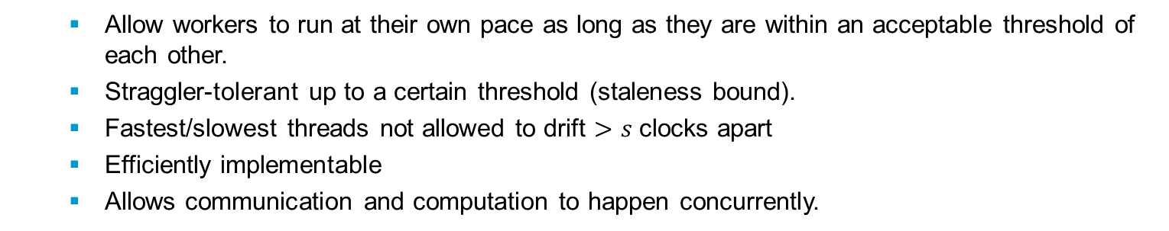
Stale Synchronous Parallel (SSP)
Between BSP and Async (subsumes both)
Black: all workers see these updates.
Blue: unspecified, workers may see it or not.
Allow workers to run at their own pace as long as they are within an acceptable threshold of each other.
Straggler-tolerant up to a certain threshold (staleness bound).
Fastest/slowest threads not allowed to drift $>s$ clocks apart
Efficiently implementable
Allows communication and computation to happen concurrently.
Notes:
Ajouter une photo d’un vieux telegraphe, puis un mobile satellitte ancienne generation…can someone find an even older wireless communication system (smoke)

Slide 19
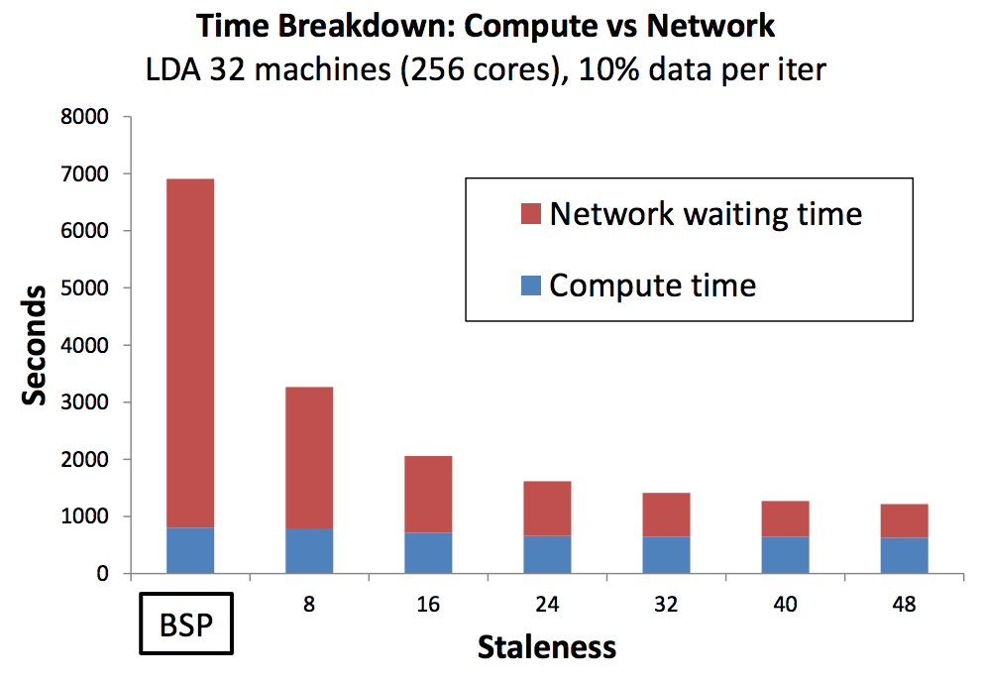
Consistency
Consistency: how recent workers views of shared variables are.
Strong consistency
Relaxed consistency
BSP: consistent - Async: not consistent.
Reduced network time with relaxed consistency.
Suitable delay/staleness (SSP) gives big speed-up
Notes:
Ajouter une photo d’un vieux telegraphe, puis un mobile satellitte ancienne generation…can someone find an even older wireless communication system (smoke)

Slide 20
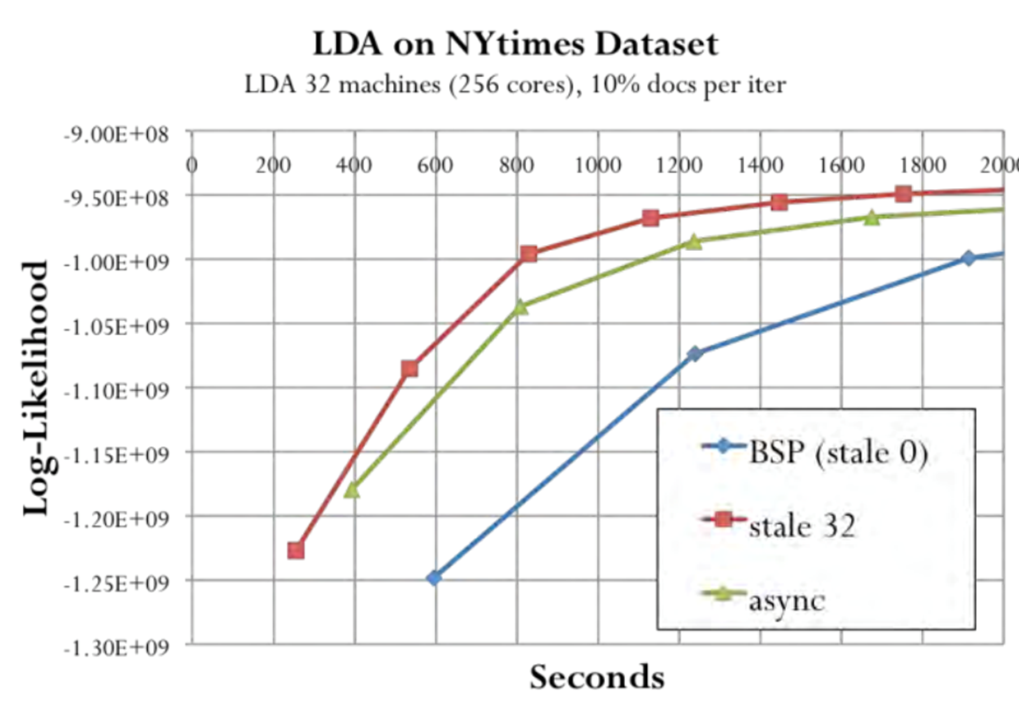
SSP Performance
SSP with correct staleness value is better than Async and BSP.
SSP retains theoretical convergence guarantees.
Notes:
Ajouter une photo d’un vieux telegraphe, puis un mobile satellitte ancienne generation…can someone find an even older wireless communication system (smoke)

Slide 21
System Architectures
Model/Gradient aggregation
Parameter Server
All-to-All
(All Reduce)
Decentralized / Gossip
Notes:
Ajouter une photo d’un vieux telegraphe, puis un mobile satellitte ancienne generation…can someone find an even older wireless communication system (smoke)

Slide 22
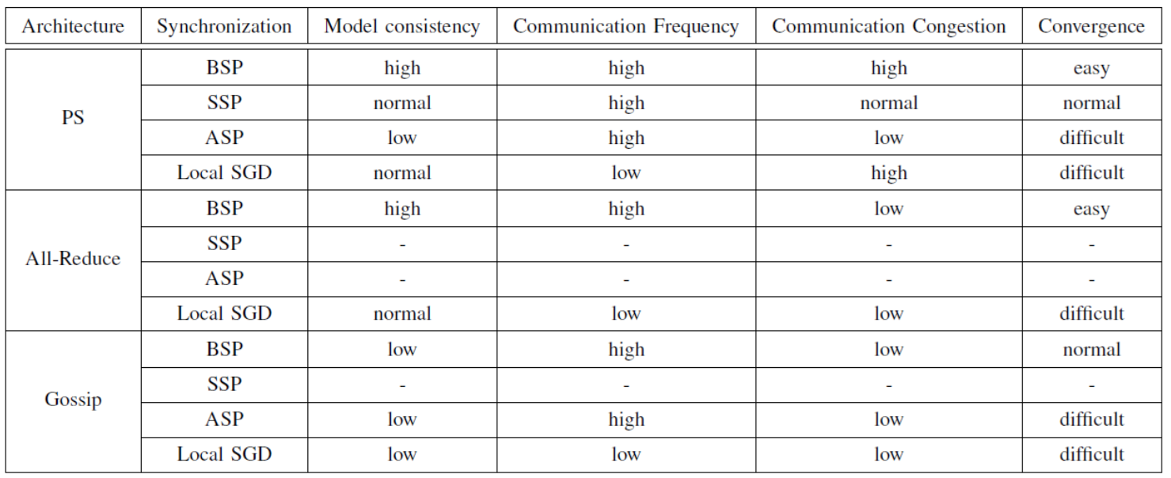
System Architectures & Synchronization
Model consistency measures how local models are different from others
Communication frequency measures how frequently workers communicate with others
Communication congestion measures how heavy the traffic of the central node is
BSP: synchronous / SSP: stale synchronous / ASP: asynchronous
Notes:
Ajouter une photo d’un vieux telegraphe, puis un mobile satellitte ancienne generation…can someone find an even older wireless communication system (smoke)

Slide 23
Communication-Efficient First-order Methods
Communication Round Minimization
Accelerating mini-batch SGD:
use the largest possible mini-batch that does not hurt the sample complexity
Variance Reduction techniques:
each device collects spatially distributed data and devices are allowed to communicate only with direct neighbors.
How to tackle statistical heterogeneity of data? (hinders the fast convergence)
Communication Bandwidth Minimization
Target: reduce the size of local updates from each device, thereby reducing the overall communication cost.
3 representative techniques: gradient reuse, gradient quantization, and gradient sparsification
Gradient Reuse:
Key observation: gradients of some devices vary slowly between two consecutive communication rounds
Lazily Aggregated Gradient (LAG):
use outdated gradients of these devices at the fusion center
some devices upload nothing during a communication round ⇒ communication overhead per round significantly reduced
Notes:
Ajouter une photo d’un vieux telegraphe, puis un mobile satellitte ancienne generation…can someone find an even older wireless communication system (smoke)

Slide 24
Lazily Aggregated Gradients
Gradient Reuse
Minimization of a sum of smooth loss functions distributed among multiple devices
Per iteration communication overhead for M uploads (one per worker)
Notes:
Ajouter une photo d’un vieux telegraphe, puis un mobile satellitte ancienne generation…can someone find an even older wireless communication system (smoke)

Slide 25
Lazily Aggregated Gradients
Select a subset of workers $ℳ^{k}⊆ℳ$ to upload
Remaining workers in ${ℳ/ℳ}^{k}$ do not upload
Notes:
Ajouter une photo d’un vieux telegraphe, puis un mobile satellitte ancienne generation…can someone find an even older wireless communication system (smoke)

Slide 26
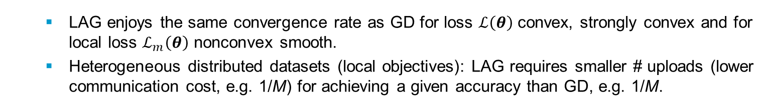
Lazily Aggregated Gradient: Performance
LAG enjoys the same convergence rate as GD for loss $ℒ\left(θ\right)$ convex, strongly convex and for local loss $ℒ_{m}\left(θ\right)$ nonconvex smooth.
Heterogeneous distributed datasets (local objectives): LAG requires smaller # uploads (lower communication cost, e.g. 1/M) for achieving a given accuracy than GD, e.g. 1/M.
Performance – Logistic Regression (real datasets, M=9 workers)
Cyc-/Num-IAG: cyclic/non-uniform update of incremental aggregated gradient
LAG needs same number of iterations but fewer uploads
Notes:
Ajouter une photo d’un vieux telegraphe, puis un mobile satellitte ancienne generation…can someone find an even older wireless communication system (smoke)

Slide 27
Periodic Averaging SGD (PASGD)
Mini-batch SGD
𝑅 = 𝑇/𝐾 steps of SGD with mini-batch size 𝐾𝑀
PASGD / Local SGD
Workers perform K local updates
Local models are averaged after every K local steps
• Performs very well empirically
• Best of both worlds?
• Makes 𝐾𝑅 updates (vs. only 𝑅 for mini-batch SGD)
• Leverages parallelism (unlike Single-Machine SGD)
Notes:
Ajouter une photo d’un vieux telegraphe, puis un mobile satellitte ancienne generation…can someone find an even older wireless communication system (smoke)

Slide 28
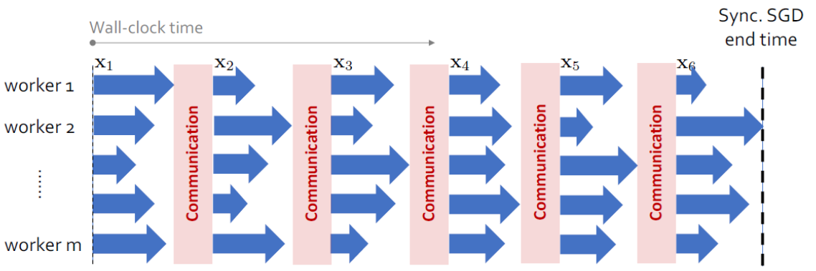
Periodic Averaging / Local SGD
Notes:
Ajouter une photo d’un vieux telegraphe, puis un mobile satellitte ancienne generation…can someone find an even older wireless communication system (smoke)

Slide 29
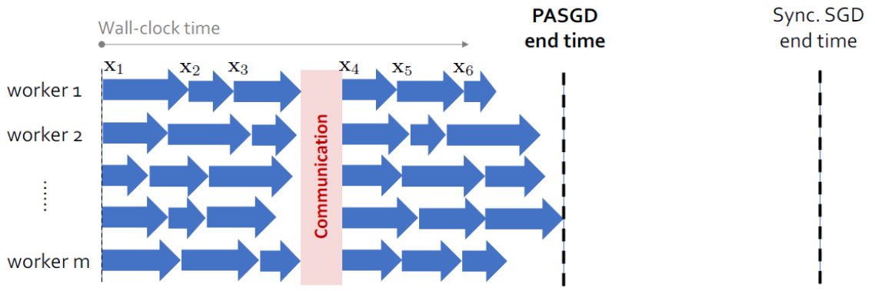
Periodic Averaging / Local SGD
Communication delay is reduced by K times
Notes:
Ajouter une photo d’un vieux telegraphe, puis un mobile satellitte ancienne generation…can someone find an even older wireless communication system (smoke)

Slide 30
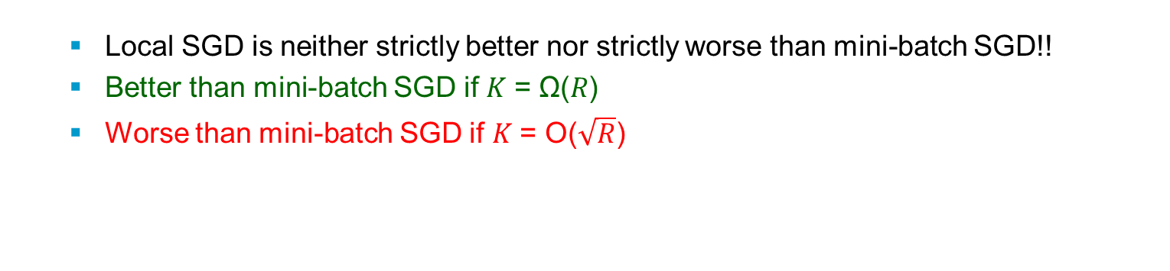
Local SGD vs. Mini-batch SGD
Local SGD is neither strictly better nor strictly worse than mini-batch SGD!!
Better than mini-batch SGD if 𝐾 = Ω(𝑅)
Worse than mini-batch SGD if 𝐾 = O($\sqrt{R}$)
Performance Comparison
Logistic regression experiment
“Thumb-Twiddling SGD” (𝑅 steps, mini-batch size 𝑀)
Notes:
Ajouter une photo d’un vieux telegraphe, puis un mobile satellitte ancienne generation…can someone find an even older wireless communication system (smoke)

Slide 31
Expected Runtime of SGD Variants
Sync variants
Fully Sync-SGD
K-sync SGD
K-batch-sync SGD
w₀
w₁
w₂
w₀
w₁
w₂
w₀
w₁
w₂
PS
PS
PS
L₁
L₁
L₁
L₂
L₂
L₂
L₃
L₃
L₃
Fully Sync-SGD: we wait for all learners to complete computation.
Once one step is complete, model weights are then combined and distributed to all learners, and the next batch of training begins.
Inefficient: learners are idle for most of the time
https://arxiv.org/abs/1803.01113
Notes:
Ajouter une photo d’un vieux telegraphe, puis un mobile satellitte ancienne generation…can someone find an even older wireless communication system (smoke)

Slide 32
Expected Runtime of SGD Variants
Sync variants
Fully Sync-SGD
K-sync SGD
K-batch-sync SGD
w₀
w₁
w₂
w₀
w₀
w₁
w₂
PS
PS
PS
L₁
L₁
L₁
L₂
L₂
L₂
L₃
L₃
L₃
K Sync-SGD: we can wait for “K” of them.
Notes:
Ajouter une photo d’un vieux telegraphe, puis un mobile satellitte ancienne generation…can someone find an even older wireless communication system (smoke)

Slide 33
Expected Runtime of SGD Variants
Sync variants
Fully Sync-SGD
K-sync SGD
K-batch-sync SGD
w₀
w₁
w₂
w₀
w₁
w₀
w₁
w₂
PS
PS
PS
L₁
L₁
L₁
L₂
L₂
L₂
L₃
L₃
L₃
K Sync-SGD: we can wait for “K” of them.
Notes:
Ajouter une photo d’un vieux telegraphe, puis un mobile satellitte ancienne generation…can someone find an even older wireless communication system (smoke)

Slide 34
Expected Runtime of SGD Variants
Sync variants
Fully Sync-SGD
K-sync SGD
K-batch-sync SGD
w₀
w₁
w₂
w₀
w₁
w₀
w₁
w₂
PS
PS
PS
L₁
L₁
L₁
L₂
L₂
L₂
L₃
L₃
L₃
K Sync-SGD: we can wait for “K” of them.
Notes:
Ajouter une photo d’un vieux telegraphe, puis un mobile satellitte ancienne generation…can someone find an even older wireless communication system (smoke)

Slide 35
Expected Runtime of SGD Variants
Sync variants
Fully Sync-SGD
K-sync SGD
K-batch-sync SGD
w₀
w₁
w₂
w₀
w₁
w₂
w₀
w₁
w₂
PS
PS
PS
L₁
L₁
L₁
L₂
L₂
L₂
L₃
L₃
L₃
K Sync-SGD: we can wait for “K” of them.
Some learners still have to wait until K of them have completed execution, and we are throwing away the work we did at N-K learner
Notes:
Ajouter une photo d’un vieux telegraphe, puis un mobile satellitte ancienne generation…can someone find an even older wireless communication system (smoke)

Slide 36
Expected Runtime of SGD Variants
Sync variants
Fully Sync-SGD
K-sync SGD
K-batch-sync SGD
w₀
w₁
w₂
w₀
w₁
w₂
w₀
PS
PS
PS
L₁
L₁
L₁
L₂
L₂
L₂
L₃
L₃
L₃
K-batch-sync-SGD: update at the end of K batches of data, instead of K workers.
Notes:
Ajouter une photo d’un vieux telegraphe, puis un mobile satellitte ancienne generation…can someone find an even older wireless communication system (smoke)

Slide 37
Expected Runtime of SGD Variants
Sync variants
Fully Sync-SGD
K-sync SGD
K-batch-sync SGD
w₀
w₁
w₂
w₀
w₁
w₂
w₀
w₁
PS
PS
PS
L₁
L₁
L₁
L₂
L₂
L₂
L₃
L₃
L₃
K-batch-sync-SGD: update at the end of K batches of data, instead of K workers.
Notes:
Ajouter une photo d’un vieux telegraphe, puis un mobile satellitte ancienne generation…can someone find an even older wireless communication system (smoke)

Slide 38
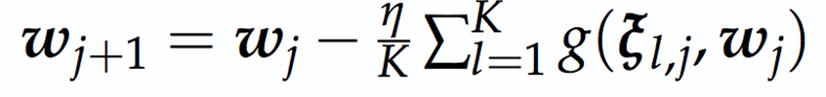
Expected Runtime of SGD Variants
Sync variants
Fully Sync-SGD
K-sync SGD
K-batch-sync SGD
w₀
w₁
w₂
w₀
w₁
w₂
w₀
w₁
w₂
PS
PS
PS
L₁
L₁
L₁
L₂
L₂
L₂
L₃
L₃
L₃
Notes:
Ajouter une photo d’un vieux telegraphe, puis un mobile satellitte ancienne generation…can someone find an even older wireless communication system (smoke)

Slide 39
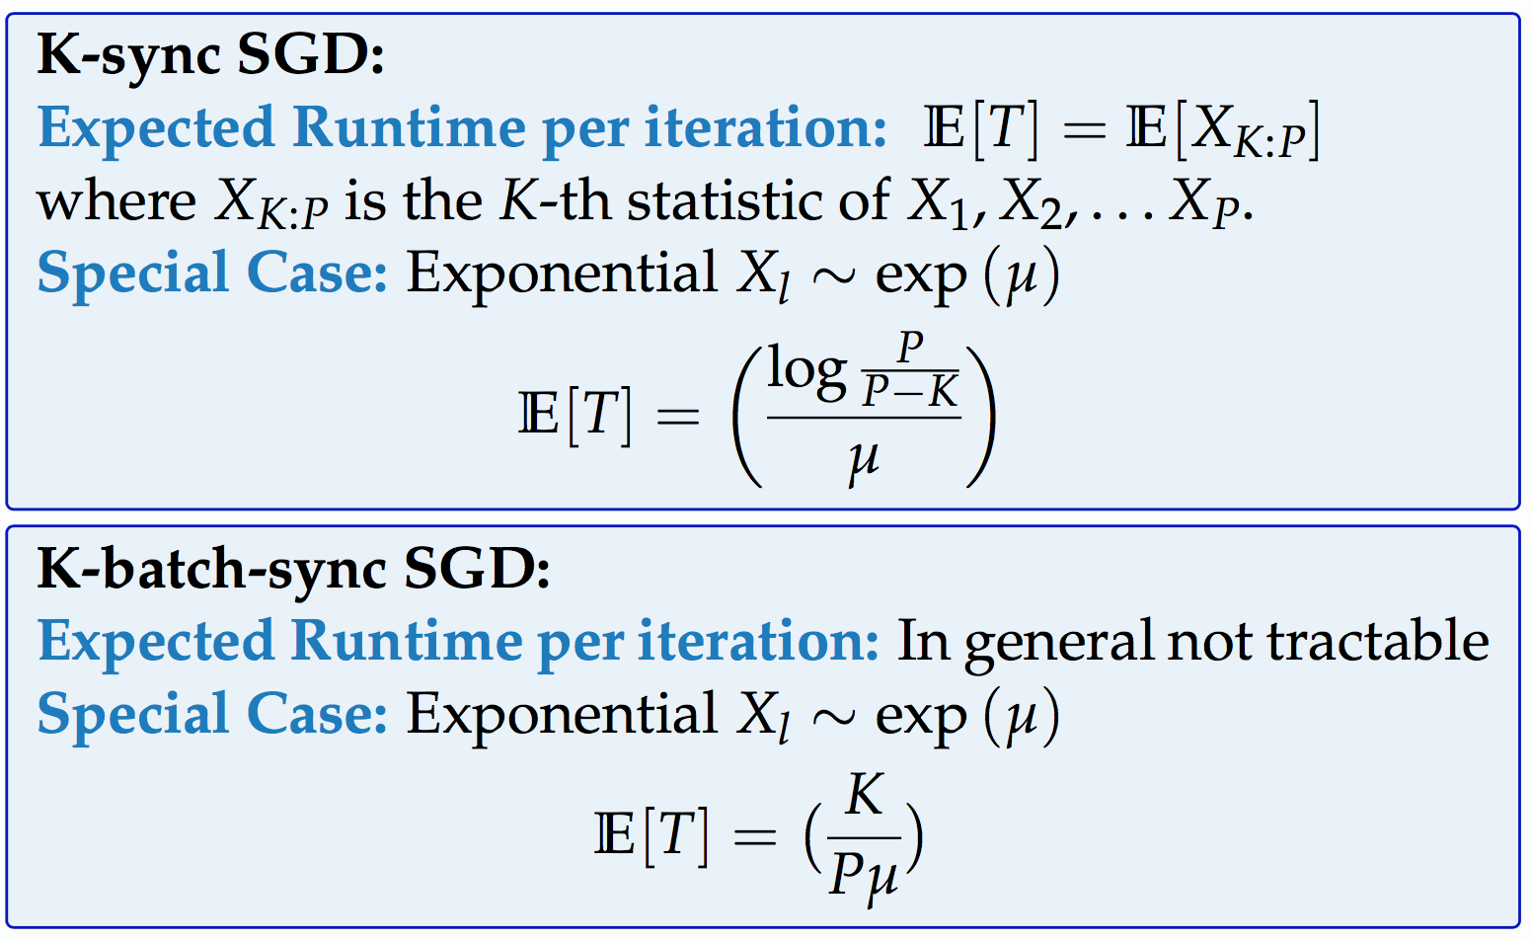
Expected Runtime of SGD Variants
K-sync SGD
K-batch-sync SGD
w₀
w₁
w₂
w₀
w₁
w₂
PS
PS
L₁
L₁
L₂
L₂
L₃
L₃
Notes:
Ajouter une photo d’un vieux telegraphe, puis un mobile satellitte ancienne generation…can someone find an even older wireless communication system (smoke)

Slide 40
Expected Runtime of SGD Variants
K-sync SGD
K-batch-sync SGD
w₀
w₁
w₂
w₀
w₁
w₂
PS
PS
L₁
L₁
L₂
L₂
L₃
L₃
Key idea: Every gradient push – minimum of P exponentials
Notes:
Ajouter une photo d’un vieux telegraphe, puis un mobile satellitte ancienne generation…can someone find an even older wireless communication system (smoke)

Slide 41
Expected Runtime of SGD Variants
K-sync SGD
K-batch-sync SGD
w₀
w₁
w₂
w₀
w₁
w₂
PS
PS
L₁
L₁
L₂
L₂
L₃
L₃
Notes:
Ajouter une photo d’un vieux telegraphe, puis un mobile satellitte ancienne generation…can someone find an even older wireless communication system (smoke)

Slide 42
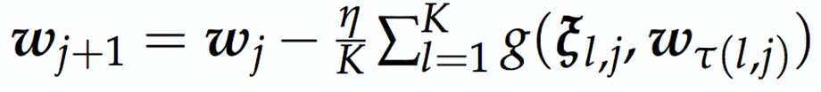
Expected Runtime of SGD Variants
Async variants
Async SGD
K-Async SGD
K-Batch Async SGD
w₀
w₁
w₂
w₃
w₀
w₁
w₂
w₃
w₀
w₁
w₂
w₃
PS
PS
PS
L₁
L₁
L₁
L₂
L₂
L₂
L₃
L₃
L₃
Notes:
Ajouter une photo d’un vieux telegraphe, puis un mobile satellitte ancienne generation…can someone find an even older wireless communication system (smoke)

Slide 43
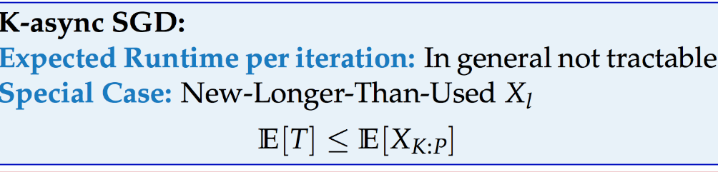
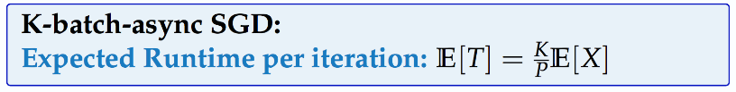
Expected Runtime of SGD Variants
Async variants
K-Async SGD
K-Batch Async SGD
w₀
w₁
w₂
w₃
w₀
w₁
w₂
w₃
PS
PS
L₁
L₁
L₂
L₂
L₃
L₃
Notes:
Ajouter une photo d’un vieux telegraphe, puis un mobile satellitte ancienne generation…can someone find an even older wireless communication system (smoke)

Slide 44
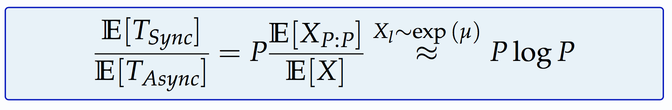
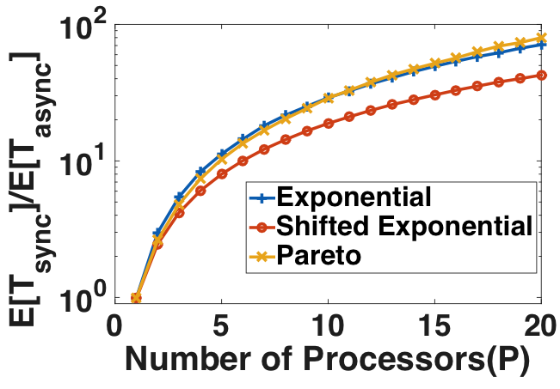
Comparison of Expected Runtime
Notes:
Ajouter une photo d’un vieux telegraphe, puis un mobile satellitte ancienne generation…can someone find an even older wireless communication system (smoke)

Slide 45
Error – Runtime Tradeoff
Async SGD
K-Batch Async
K-Async SGD
Error at Convergence
K=2
K=2
K=3
K=4
FullySync
K=3
K=4
Batch Sync
Runtime
https://arxiv.org/abs/1803.01113
Notes:
Ajouter une photo d’un vieux telegraphe, puis un mobile satellitte ancienne generation…can someone find an even older wireless communication system (smoke)

Slide 46
Communication-efficient Algorithms
Second-order Methods
Exploit second order curvature information
Exact second-order methods require the computation, storage and even communication of a Hessian matrix (huge overhead)
Two main approaches
Maintain a global approximated inverse Hessian matrix in the central node
Solve a second-order approximation problem locally at each device.
Notes:
Ajouter une photo d’un vieux telegraphe, puis un mobile satellitte ancienne generation…can someone find an even older wireless communication system (smoke)

Slide 47
Communication-Efficient
ML Systems

Slide 48
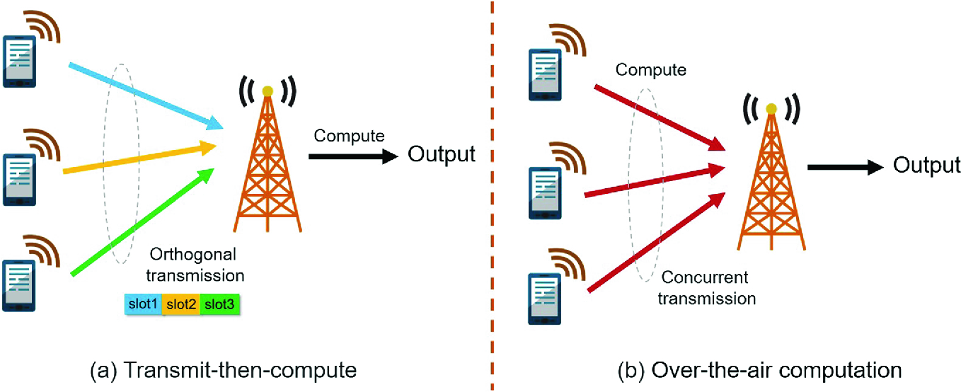
Fast Aggregation with Over-the-Air Computation
Comm. – Computation Separation
Transmit/Receive, then Compute
Orthogonal uplink access
Non-Orthogonal access: interference cancelation at Rx
Over-the-Air Computation (AirComp)
Wireless shared medium
Exploit signal superposition property
Analog transmissions?
Synchronization!!!
Notes:
Ajouter une photo d’un vieux telegraphe, puis un mobile satellitte ancienne generation…can someone find an even older wireless communication system (smoke)

Slide 49
Over-the-Air Computation
Key idea
Interference can be harnessed for computing functional values instead of being canceled ⇒ efficient radio resource utilization
Main steps
Pre-processing the input data at each device
Decode directly the sum of all preprocessed data
Desired function is obtained by post-processing the summation
Main issue:
Synchronization
Notes:
Ajouter une photo d’un vieux telegraphe, puis un mobile satellitte ancienne generation…can someone find an even older wireless communication system (smoke)

Slide 50
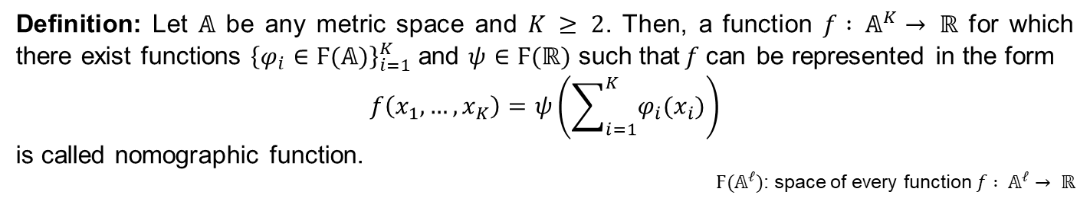
Function Computation
What kind of functions can we compute over the air?
Nomographic functions
Definition: Let $𝔸$ be any metric space and $K ≥ 2$. Then, a function $f : 𝔸^{K}→ ℝ$ for which there exist functions ${\left\{φ_{i}∈Ϝ(𝔸)\right\}}_{i=1}^{K}$ and $ψ∈Ϝ(ℝ)$ such that$f$can be represented in the form
$$f\left(x_{1},…,x_{K}\right)=ψ\left(\sum_{i=1}^{K}{φ_{i}(x_{i})}\right)$$
is called nomographic function.
$Ϝ(𝔸^{ℓ})$: space of every function $f : 𝔸^{ℓ}→ ℝ$
Examples: arithmetic mean, weighted sum, geometric mean, polynomial, Euclidean norm
${\left\{φ_{i}∈Ϝ(𝔸)\right\}}_{i=1}^{K}$: preprocessing functions, $ψ$: post-processing function
Kolmogorov – Arnold representation (superposition) theorem [1957]
every multivariate continuous function can be represented
as a superposition of continuous functions of one variable
Lorentz’s refinement implication: every continuous function of K variables is computable by a wireless (*extended*) MAC with continuous preprocessing functions using a 1-way computation network
Notes:
Ajouter une photo d’un vieux telegraphe, puis un mobile satellitte ancienne generation…can someone find an even older wireless communication system (smoke)

Slide 51
Conventional vs. ML-driven Communication
Comm. Techniques | Conventional | ML-driven
Multiple Access | Decoupling messages from users | Computing functions of distributed data
Resource Allocation | Maximize sum rate or reliability | Fast acquisition (importance aware tx)
Signal Encoding | Optimal tradeoff between rate and distortion/reliability | Latency minimization while preserving learning accuracy
Notes:
Ajouter une photo d’un vieux telegraphe, puis un mobile satellitte ancienne generation…can someone find an even older wireless communication system (smoke)

Slide 52
Straggler Mitigation

Slide 53


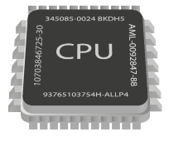
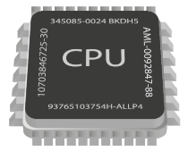
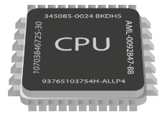
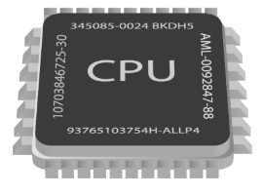
Straggling Learners
model
model
model
model
model
How to deal with stragglers?
Notes:
Ajouter une photo d’un vieux telegraphe, puis un mobile satellitte ancienne generation…can someone find an even older wireless communication system (smoke)

Slide 54
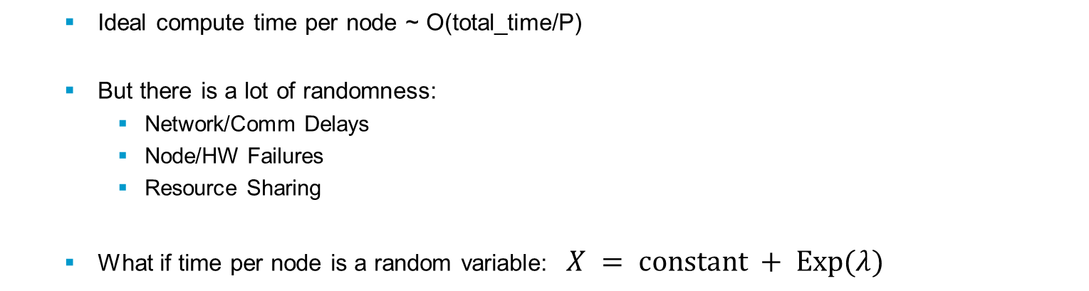
Stragglers
Ideal compute time per node ~ O(total_time/P)
But there is a lot of randomness:
Network/Comm Delays
Node/HW Failures
Resource Sharing
What if time per node is a random variable:$X = constant + Exp(λ)$
The expected runtime of the $i$ fastest nodes
Slowest node is $log⁡(n)$ times slower than fastest
Notes:
Ajouter une photo d’un vieux telegraphe, puis un mobile satellitte ancienne generation…can someone find an even older wireless communication system (smoke)

Slide 55
Simulation Results
$X(t) = 1+ Exp(0.5)$
Straggler issue:
leads to slower mini-batch SGD implementations
Notes:
Ajouter une photo d’un vieux telegraphe, puis un mobile satellitte ancienne generation…can someone find an even older wireless communication system (smoke)

Slide 56
Straggler Termination
model
model
model
model
How many nodes to wait for before moving on to next iteration?
How much does the error affect us?
Notes:
Ajouter une photo d’un vieux telegraphe, puis un mobile satellitte ancienne generation…can someone find an even older wireless communication system (smoke)

Slide 57
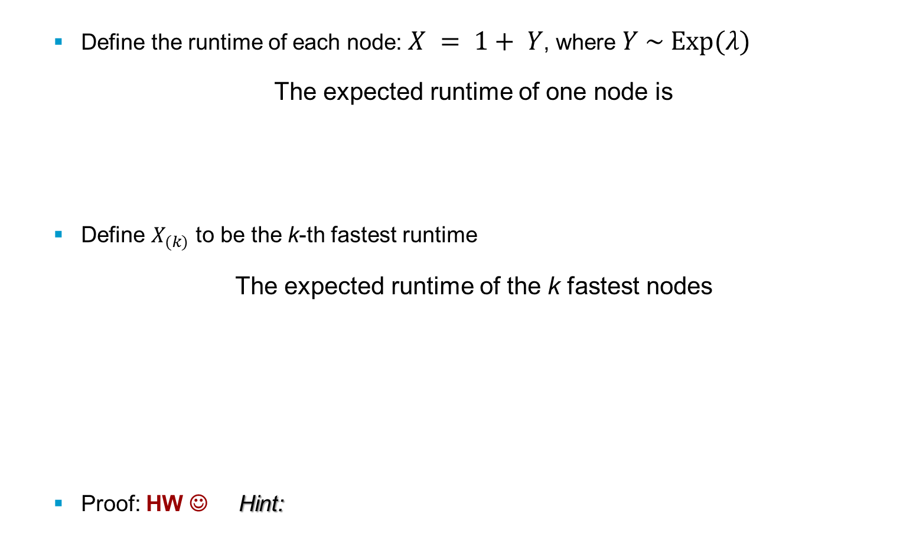
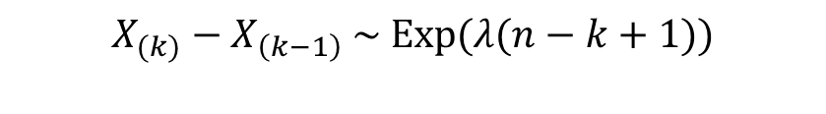
Straggler Termination: Expected Savings
Define the runtime of each node: $X = 1+ Y$, where $Y \sim Exp(λ)$
The expected runtime of one node is
Define $X_{(k)}$ to be the k-th fastest runtime
The expected runtime of the k fastest nodes
Proof: HW ☺ Hint:
$$X_{(k)}−X_{\left(k−1\right)} \sim Exp(λ(n−k+1))$$
Notes:
Ajouter une photo d’un vieux telegraphe, puis un mobile satellitte ancienne generation…can someone find an even older wireless communication system (smoke)

Slide 58
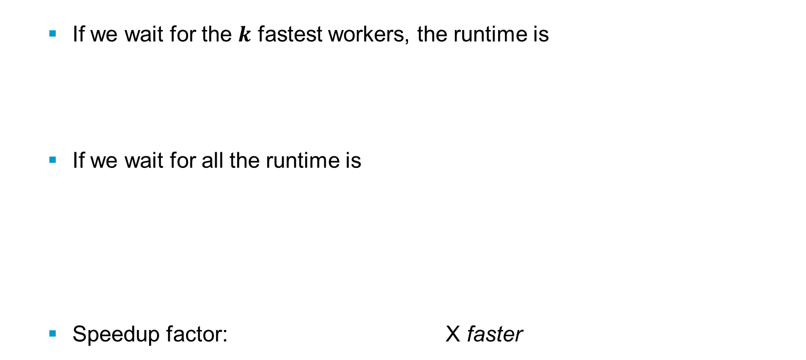
Straggler Termination: Expected Savings
If we wait for the $k$ fastest workers, the runtime is
If we wait for all the runtime is
Speedup factor: X faster
How much faster did distributed SGD become?
Notes:
Ajouter une photo d’un vieux telegraphe, puis un mobile satellitte ancienne generation…can someone find an even older wireless communication system (smoke)

Slide 59
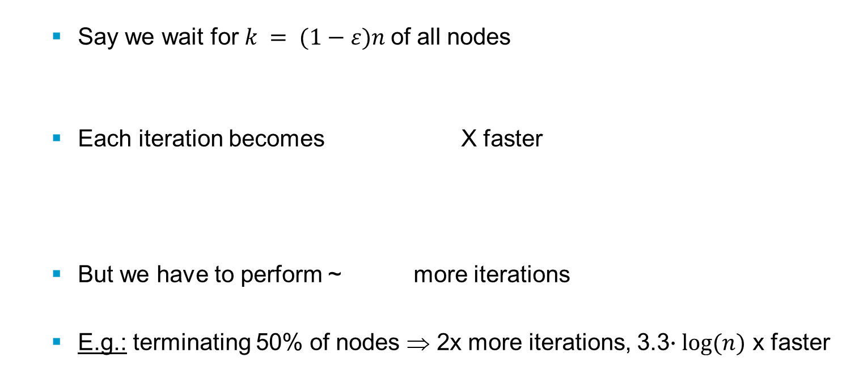
Straggler Termination: Expected Savings
Say we wait for $k = (1−ε)n$of all nodes
Each iteration becomes X faster
But we have to perform ~ more iterations
E.g.: terminating 50% of nodes ⇒ 2x more iterations, 3.3$∙log⁡(n)$ x faster
Can we do better?
Notes:
Ajouter une photo d’un vieux telegraphe, puis un mobile satellitte ancienne generation…can someone find an even older wireless communication system (smoke)

Slide 60
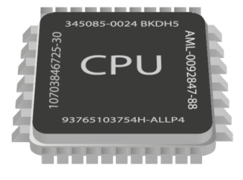
Replication & Backup Workers
What if we used some redundancy??
No loss in accuracy
Seems wasteful
Notes:
Ajouter une photo d’un vieux telegraphe, puis un mobile satellitte ancienne generation…can someone find an even older wireless communication system (smoke)

Slide 61
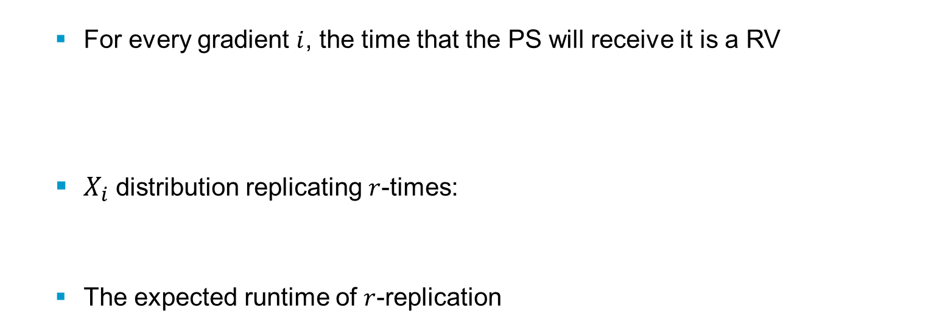
Replication: Expected Savings
For every gradient $i$, the time that the PS will receive it is a RV
$X_{i}$ distribution replicating $r$-times:
The expected runtime of $r$-replication
Notes:
Ajouter une photo d’un vieux telegraphe, puis un mobile satellitte ancienne generation…can someone find an even older wireless communication system (smoke)

Slide 62
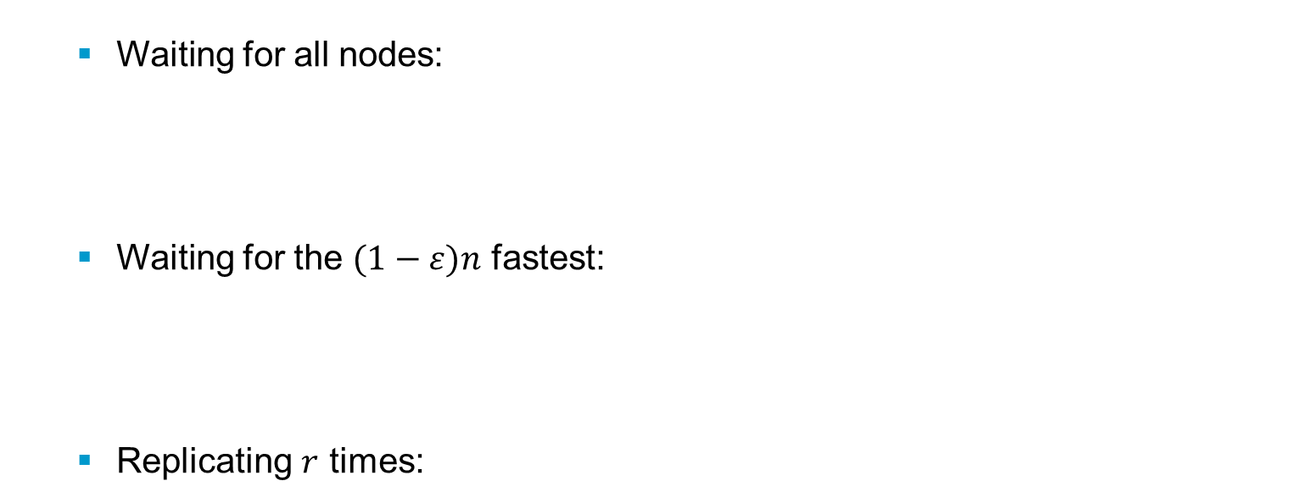
Comparison of expected times
Waiting for all nodes:
Waiting for the $(1−ε)n$ fastest:
Replicating $r$ times:
Either lose information OR compute too much
Can we do better?
Notes:
Ajouter une photo d’un vieux telegraphe, puis un mobile satellitte ancienne generation…can someone find an even older wireless communication system (smoke)

Slide 63
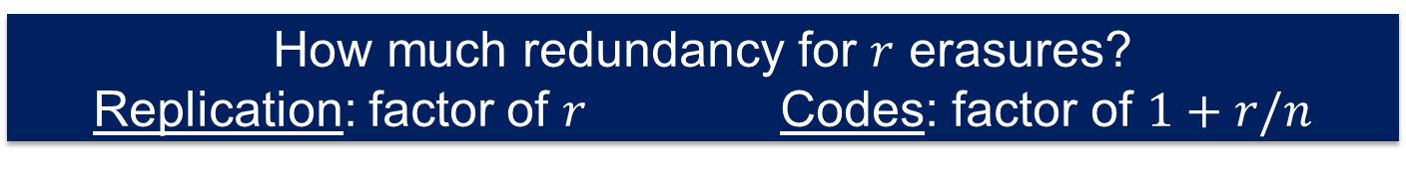
Coding Theory to the Rescue
Replication vs. Codes
A
A
B
B
Can recover A and B from any 1 erasure
Can also recover A, B from any 1 erasure
A
A+B
B
How much redundancy for $r$ erasures?
Replication: factor of $r$ Codes: factor of $1+r/n$
Notes:
Ajouter une photo d’un vieux telegraphe, puis un mobile satellitte ancienne generation…can someone find an even older wireless communication system (smoke)

Slide 64
Coding Theory to the Rescue
Noise
A
?
A
B
B
A+B
A+B
Coding: system of rules to convert information into another form of representation
Encoding: process converting information from a source into symbols for communication or storage.
Decoding: the reverse process, converting code symbols back into a form that the recipient understands.
Notes:
Ajouter une photo d’un vieux telegraphe, puis un mobile satellitte ancienne generation…can someone find an even older wireless communication system (smoke)

Slide 65
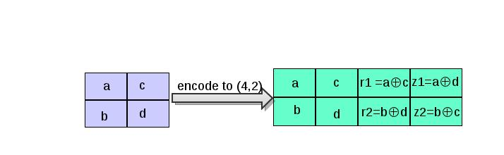
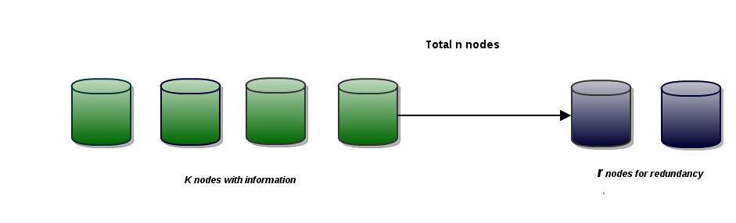
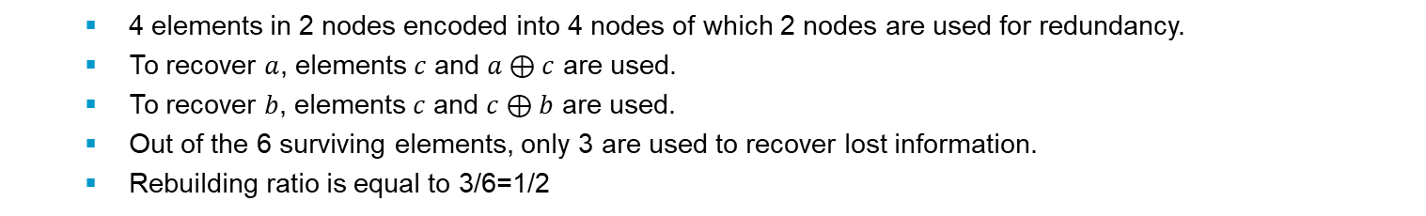
MDS Codes in a Nutshell
4 elements in 2 nodes encoded into 4 nodes of which 2 nodes are used for redundancy.
To recover $a$, elements $c$ and $a⊕c$ are used.
To recover $b$, elements $c$ and $c⊕b$ are used.
Out of the 6 surviving elements, only 3 are used to recover lost information.
Rebuilding ratio is equal to 3/6=1/2
$(n,k)$- MDS code: $n$ is the total # nodes of which
$k$ is #nodes containing information
$r=n−k$ nodes as redundancy
Notes:
Ajouter une photo d’un vieux telegraphe, puis un mobile satellitte ancienne generation…can someone find an even older wireless communication system (smoke)

Slide 66

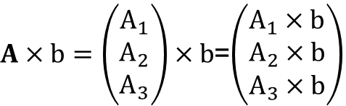
Distributed Matrix-Vector Multiplication
$A×b=\left(\begin{aligned}A_{1} \\ A_{2} \\ A_{3}\end{aligned}\right)×b$=$\left(\begin{aligned}A_{1}×b \\ A_{2}×b \\ A_{3}×b\end{aligned}\right)$
Task: multiply A and b
Distributed setup: 3 workers, 1 master
A₁b
M
A₂b
A₁
A₃b
A
A₂
W₁
W₂
W₃
A₃
A₁
b
A₂
b
A₃
b
Uncoded Algorithm
Notes:
Ajouter une photo d’un vieux telegraphe, puis un mobile satellitte ancienne generation…can someone find an even older wireless communication system (smoke)

Slide 67
Coded Matrix Multiplication
A’₁b
M
A₁
A’₁
A’₂b
A
A₂
A
W₁
W₂
W₃
A’₂
A₃
A’₁
b
A’₂
b
_{(A’1+A’2)}
b
+
Coded Algorithm
Notes:
Ajouter une photo d’un vieux telegraphe, puis un mobile satellitte ancienne generation…can someone find an even older wireless communication system (smoke)

Slide 68


MDS-Coded Matrix Multiplication
M
A₁b
M
A₁b
A₁
A₂b
Ab
A₁
Ab
A₃b
A₂b
A
A₂
A
W₁
W₂
W₃
A₂
W₁
W₂
W₃
A₃
A₁
b
A₂
b
A₃
b
A₁
b
A₂
b
A₁+A₂
b
W₁
W₁
W₂
W₂
W₃
W₃
Gain
Time(uncoded)
= slowest node
Time(MDS coded)
= 2nd slowest node
Notes:
Ajouter une photo d’un vieux telegraphe, puis un mobile satellitte ancienne generation…can someone find an even older wireless communication system (smoke)

Slide 69

Comparison of expected times
Waiting for all nodes:
Waiting for the $(1−ε)n$ fastest [incur loss]:
Replicating $r$ times:
($(1+ε)n, n$)–MDS code [no loss]:
Notes:
Ajouter une photo d’un vieux telegraphe, puis un mobile satellitte ancienne generation…can someone find an even older wireless communication system (smoke)

Slide 70

Coded Computation for Linear Operations
Can be applied to:
Linear regression
Fixed point type algorithms (SVD, PageRank, etc.)
Notes:
Ajouter une photo d’un vieux telegraphe, puis un mobile satellitte ancienne generation…can someone find an even older wireless communication system (smoke)

Slide 71


Experimental Results
$$E[T]$$
$$(ms)$$
500
4-rep
400
3-rep
uncoded (1-rep)
300
2-rep
> 30% speed up
(24,23)
Done with 24 EC2 machines
(24,22)
(24,20)
$$k$$
200
6 8 10 12 14 16 18 20 22 24
Notes:
Ajouter une photo d’un vieux telegraphe, puis un mobile satellitte ancienne generation…can someone find an even older wireless communication system (smoke)

Slide 72

Distributed Linear Regression
Notes:
Ajouter une photo d’un vieux telegraphe, puis un mobile satellitte ancienne generation…can someone find an even older wireless communication system (smoke)

Slide 73

Gradient Coding
Notes:
Ajouter une photo d’un vieux telegraphe, puis un mobile satellitte ancienne generation…can someone find an even older wireless communication system (smoke)

Slide 74

Gradient Coding
Notes:
Ajouter une photo d’un vieux telegraphe, puis un mobile satellitte ancienne generation…can someone find an even older wireless communication system (smoke)

Slide 75

Gradient Coding
Notes:
Ajouter une photo d’un vieux telegraphe, puis un mobile satellitte ancienne generation…can someone find an even older wireless communication system (smoke)

Slide 76

Gradient Coding
Notes:
Ajouter une photo d’un vieux telegraphe, puis un mobile satellitte ancienne generation…can someone find an even older wireless communication system (smoke)

Slide 77

Gradient Coding
Notes:
Ajouter une photo d’un vieux telegraphe, puis un mobile satellitte ancienne generation…can someone find an even older wireless communication system (smoke)

Slide 78

Gradient Coding
This is the unique solution that achieves minimum communication overhead
Notes:
Ajouter une photo d’un vieux telegraphe, puis un mobile satellitte ancienne generation…can someone find an even older wireless communication system (smoke)

Slide 79
Federated Learning

Slide 80
What is Federated Learning?
In a nutshell, broadly speaking…. FL = Privacy-Preserving Collaborative ML keeping the (training) data decentralized
Instead of making predictions in the cloud, distribute the model, make predictions on device
Key Features:
On-device datasets: end users keep raw data locally (privacy by default)
On-device training: end-user devices perform training on a shared model
Federated learning: a shared global model is trained via federated computation
Federated computation: server collects trained weights from end users and update the shared model (i.e., coordinates a fleet of participating devices to compute aggregations of devices’ private data)
Notes:
Ajouter une photo d’un vieux telegraphe, puis un mobile satellitte ancienne generation…can someone find an even older wireless communication system (smoke)

Slide 81

Basic Federated Learning Operation
Iterate the following process till convergence
At devices: perform local training, send the trained weights to aggregator
At aggregator: average the model, redistribute to the devices
We want the final model to be:
as good as the centralized solution (ideally)
at least better than what each party can learn on its own
device (e.g. phone) personalizes the model locally, based on its user usage (local dataset)
many users' updates are aggregated
to form a consensus change
to the shared model
… and the procedure is repeated
Notes:
Ajouter une photo d’un vieux telegraphe, puis un mobile satellitte ancienne generation…can someone find an even older wireless communication system (smoke)

Slide 82

Federated Optimization
Iteratively perform a local training algorithm (e.g., multiple steps of SGD) based on the dataset at each device
Aggregate the local updated models, i.e., compute the average (or weighted average) of the local updated model parameters.
Notes:
Ajouter une photo d’un vieux telegraphe, puis un mobile satellitte ancienne generation…can someone find an even older wireless communication system (smoke)

Slide 83
Federated Learning vs. Distributed Learning
Characteristics of federated learning vs. traditional distributed learning
Data locality and distribution
massively decentralized, naturally arising (non-IID) partition
Data is siloed, held by a small number of coordinating entities
system-controlled (e.g. shuffled, balanced)
Data availability
limited availability, time-of-day variations
almost all data nodes always available
Addressability
data nodes are anonymous and interchangeable
data nodes are addressable
Node statefullness
stateless (generally no repeat computation)
statefull
Node reliability
unreliable (~10% failures)
reliable
Wide-area communication pattern
hub-and-spoke topology
peer-to-peer topology (fully decentralized)
none (centralized to one datacenter)
Distribution scale
massively parallel (1e9 data nodes)
single datacenter
Primary bottleneck
communication
computation
Notes:
Ajouter une photo d’un vieux telegraphe, puis un mobile satellitte ancienne generation…can someone find an even older wireless communication system (smoke)

Slide 84
Federated Learning Variants
Cross-device FL
Cross-silo FL
Massive number of parties (up to 10¹⁰)
Small dataset per party (could be size 1)
Limited availability and reliability
Some parties may be malicious
2 - 100 parties
Medium to large dataset per party
Reliable parties, almost always available
Parties are typically honest
Notes:
Ajouter une photo d’un vieux telegraphe, puis un mobile satellitte ancienne generation…can someone find an even older wireless communication system (smoke)

Slide 85


Federated Learning Variants
Server-orchestrated FL
Fully decentralized FL
Server-client communication
Global coordination, global aggregation
Server is a single point of failure and may become a bottleneck
Device-to-device communication
No global coordination, local aggregation
Naturally scales to a large number of devices
Notes:
Ajouter une photo d’un vieux telegraphe, puis un mobile satellitte ancienne generation…can someone find an even older wireless communication system (smoke)

Slide 86
Federated Learning Challenges
Massively Distributed
Training data is stored across a very large number of devices
Limited Communication
Only a handful of rounds of unreliable communication with each devices
Unbalanced Data
Some devices have few examples, some have orders of magnitude more
Highly Non-IID Data
Data on each device reflects one individual's usage pattern
Unreliable Compute Nodes
Devices go offline unexpectedly; expect faults and adversaries
Dynamic Data Availability
The subset of data available is non-constant, e.g. time-of-day vs. country
FL over Wireless Networks
Communication medium is shared and resource-constrained
Only a limited number of devices can be selected in each update round
Transmissions are not reliable due to interference
Typical orders-of-magnitude
100-1000s of users per round
100-1000s of rounds to convergence
1-10 minutes per round
Notes:
Ajouter une photo d’un vieux telegraphe, puis un mobile satellitte ancienne generation…can someone find an even older wireless communication system (smoke)

Slide 87


Constraints in the federated setting
Each device reflects one users' data.
So no one device is representative of the whole population.
Devices must idle, plugged-in, on WiFi to participate.
Device availability correlates with both geo location and data distribution.
H. Eichner, et al. Semi-Cyclic Stochastic Gradient Descent. ICML 2019.
Notes:
Ajouter une photo d’un vieux telegraphe, puis un mobile satellitte ancienne generation…can someone find an even older wireless communication system (smoke)

Slide 88

Federated Averaging
Notes:
Ajouter une photo d’un vieux telegraphe, puis un mobile satellitte ancienne generation…can someone find an even older wireless communication system (smoke)

Slide 89

Federated Averaging
Notes:
Ajouter une photo d’un vieux telegraphe, puis un mobile satellitte ancienne generation…can someone find an even older wireless communication system (smoke)

Slide 90
Federated Averaging Algorithm
Potential bottleneck
Notes:
Ajouter une photo d’un vieux telegraphe, puis un mobile satellitte ancienne generation…can someone find an even older wireless communication system (smoke)

Slide 91

Federating Averaging Performance
Large-scale LSTM for next-word prediction
Dataset: Large Social Network, 10m public posts, grouped by author.
H. B. McMahan, et al. Communication-Efficient Learning of
Deep Networks from Decentralized Data. AISTATS 2017
Notes:
Ajouter une photo d’un vieux telegraphe, puis un mobile satellitte ancienne generation…can someone find an even older wireless communication system (smoke)

Slide 92


Federating Averaging Performance
CIFAR-10 convolutional model
H. B. McMahan, et al. Communication-Efficient Learning of
Deep Networks from Decentralized Data. AISTATS 2017
Notes:
Ajouter une photo d’un vieux telegraphe, puis un mobile satellitte ancienne generation…can someone find an even older wireless communication system (smoke)

